Slide 1






UNIVERSITY of EXETER
Jackson-Grime-Davies Summer Internship 2021
Introductory Zoom Meeting
Dr Mick Jackson - June 2021
1979 - 1983

Slide 2
Exeter University - Internship Meeting
Overview
Background, Ethos and aims of the JGD internship
Value of internships to the undergraduate/ graduate
Employer’s view of an internship – CV or interview
What are “Good Projects”?
What makes a good proposal?
Selection Process

Slide 3
Exeter University - Internship Meeting
My Background
PhD in Chemical Engineering at Exeter, Research Assistant position sponsored by ECC
Didn’t do research as a career but would not have missed the experience for anything!
30 year career in oil and gas
Petroleum Engineering, Economics, Commercial, General Management, Audit & Risk Management
Netherlands, Ukraine, India, Indonesia
I Want to give back to the University & encourage new generations of students to consider research
1979 - 1983

Slide 4
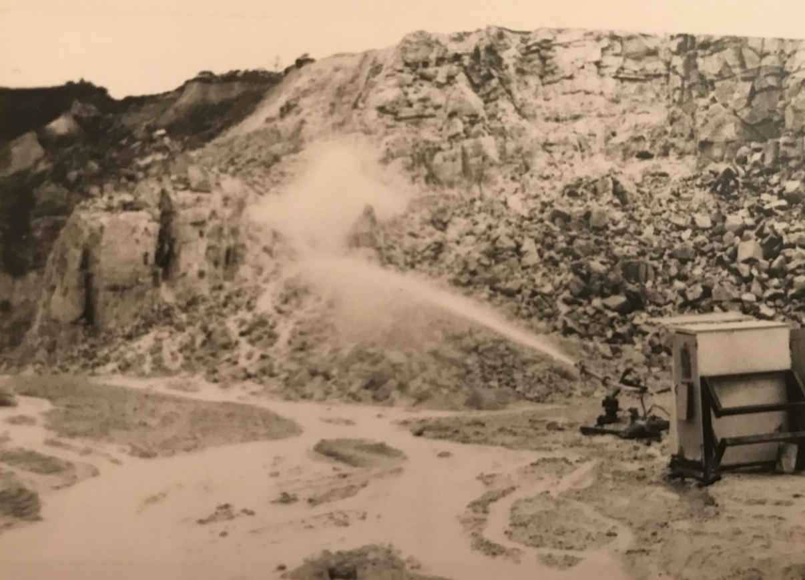
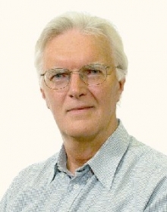

Exeter University - Internship Meeting
The subject of Mick Jackson’s PhD:
Hydraulic Mining of China Clay at ECC Ltd Pit in St Austell, Cornwall.
Prof Tom Davies
(PhD Supervisor)
Barry Grime (ECLP Engineering Director)

Slide 5
Exeter University - Internship Meeting
Specifically the two-phase (water & air) characteristics of large scale, high pressure, water jets

Slide 6
Exeter University - Internship Meeting
Whilst the jets begin as solid bars of water they rapidly break up into packets (photos under strobe)

Slide 7
Exeter University - Internship Meeting
Ethos and Aims
Ethos
Collaboration between University & 3rd Parties
Multi-Disciplinary, “Joined-up Thinking”
Use of technology for the benefit of mankind & the planet
Aims
Opportunity to gain real insight & experience of projects
Opportunity to demonstrate ability to make a difference
To Inspire students to think about research!

Slide 8
Exeter University - Internship Meeting
History of the JGD awards
Open to College of Engineering, Maths & Physical Sciences and generally targeted at students finishing their second year.
2018 - 1 / 2 students - Biology, Physics
2019 - 2 students – Biomed
2020 - 5 students – Geology x2, Mining Geology, Biology, Biomed
2021 – 4 awards available – 2 x Penryn, 2 x Streatham

Slide 9
Exeter University - Internship Meeting
Students & Project titles
2018
Natalie Cotterell – Investigating formin4 activity related to MAMP & DAMP responses
Saskia Sherwood – The impact of Faraday waves on movement patterns of micro-plastics
2019
Alice Franklin – Developing Deep Raman Spectroscopy for in vivo mouse studies of Alzheimer's disease
Jay Acharya – Raman Imaging Agents for use in Biomedical Diagnostics
2020
James Harvey – The potential for European Antimony production from historic data and known small deposits of economic potential
Eira James – constraining the age of the Hettangian Stage using cyclo-stratigraphy and sequence stratigraphy from the Wilkesley Borehole, Cheshire, UK
Alex Blackwell – Benthic foraminiferal ecology in the Bering sea during the mid Pleistocene Transition
Jim O’Connell – Identifying how uniflagellate Chamydomanas trajectories differ on a cellular level
Elise Hobson – Investigating the anisotropic structural properties of bone on a micro-scale using Raman microscopy

Slide 10
Exeter University - Internship Meeting
Value of Internships to you
Do I want to do research or PhD after graduating?
Gain paid (£1500) work experience as research team member for a 6-8 week period in July/August
What's it like to be part of a project team in academia?
“My first piece of fundamental thinking” – prepare for final year project/ MSc project
Make a contribution & record the achievement
…..Good for the CV & getting a job!

Slide 11
Exeter University - Internship Meeting
What past Interns & their supervisors say:
Natalie 2018 – “I really knew that I wanted to do career research but found the experience increased my feeling of independence and I had a feeling of pride in my contribution”
Jay 2019 – “As well as learning how to effectively plan, over the course of the internship I feel that my ability to work independently and my confidence when doing so has been increased”.
Supervisor Dr Nick Stone 2020 - “with a little more follow up work by others, you have the possibility of co-authoring a paper with the team”
Eira 2020 – “My JGD internship has been crucial in helping me secure a PhD without a master's level qualification by providing me with further experience of independent and self-led research. The internship confirmed my commitment to pursuing a career in research and has given me the confidence to apply for a PhD….”

Slide 12
Exeter University - Internship Meeting
Potential Employer's View
Demonstrates an inquisitive mind - determination to pursue an area of interest – and test the outcome
Demonstrates achievement:
  Self-motivation
  Working independently but as part of a successful team
  Imagination & creativity – Joined up Thinking
  Planning, Design & Analysis – you define the project proposal
  Commitment to required quality of outcome
  Technical & Communication skills honed
Demonstrate ability to see things differently?
Demonstrate ability to respond to change or difficulty?
Equals …..Competence & Employability!

Slide 13
Exeter University - Internship Meeting
What makes a “Good Project”?
Original research angle and or topical focus
Obvious linkage with a current research programme - More than just collecting data (experimental & modelling)
Clear desire for student and researcher to collaborate
Ability to “get results” in 6 weeks - Realistic objectives and timeframe
Provision to deal with setbacks – remember……….
– ve result ……….is nearly always +ve !!!!
………..One that you are excited about!

Slide 14
Exeter University - Internship Meeting
What makes a “Good Proposal”?
Personal aims and research objectives clearly stated
Context - Introduction demonstrates good understanding of the fundamental multidisciplinary science, its status and what potentially your contribution will add
Robust “plan” to achieve in 6 weeks
  Key stages or milestones well defined
  Quantified, Realistic timeframe with contingency
Recognises risks to both getting results and ability to analyse & make sense of them

Slide 15
Exeter University - Internship Meeting
How we will select successful candidates based on Proposal Form & Interview?
50% Based on Proposal Form
50% Based on Interview

Slide 16
Exeter University - Internship Meeting
Common pitfalls when doing projects based on interns experience to date!
Insufficient linkage between the blue sky objective and the work being undertaken
Getting too bogged down with solving one particular issue
Not sticking to the plan
Not getting help (as soon as you need it)
Not taking sufficient time to think, discuss with others & analyse data/ results
We don’t know what we don’t know until its too late!

